Slide 1
Bryan Station Girls Lacrosse
2014

Slide 2
Introduction
Background
Experience
Future

Slide 3
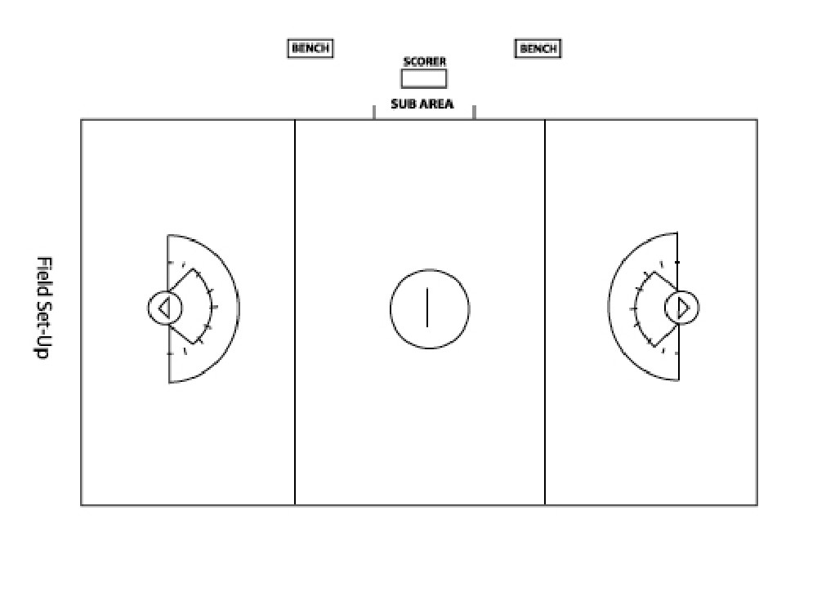
Lacrosse Basics
Players
Equipment
Spirit
Field

Slide 4
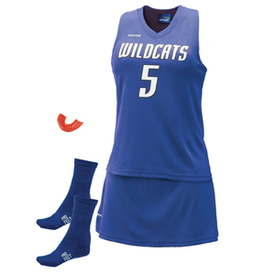
Uniforms
Package- $45.00

Slide 5
CAUTION:Sticks
Cheap is not always the best!
Offset heads are better!
Flat, spatula style cause frustration!
Bulky sticks cause injury, are heavy!

Slide 6
Budget
Equipment: Uniforms: Girls (x 20) $50 per $1000
Goalie equipment package (1) $225 per $225
Other (Balls, cones, paint, extra net) First aid (1 kit) $200 per $200
Officials: Games (4 home games) $100 per home game $400
Miscellaneous: Indoor Facility $200 $200
Coaches: Head coach (will change depending on $) $3000 $3000
TOTAL $5025
If there are 20 girls playing = $ 251
If there are 15 girls playing = $ 335
-Scholarships
-Fundraising
-Payment Plans
-Future Years to come

Slide 7
Fundraising
Discount Meal Cards (Boys team does this)
Chocolate Bars (School does this)
Wreaths for Christmas (need to do quickly)
Yard Sale (Spring time)
Car Wash (Spring time)
Rupp Arena (Concessions?)
Lexington Legends (Concessions?)
Sponsors (Banner advertising)
Bumper Stickers
Any other ideas?

Slide 8
Practice
Open Fields- Fall (2 times a week or more!)
Indoor – Winter (1 time a week depending on $)
Practice – Spring 5:30-7:30 (share with boys team) 5 days a week

Slide 9
Expectations
School First
Attendance (practice and games)
Excitement
Effort
Volunteers (Parents & Students)

Slide 10
Communication
Remind 101- To: 606-257-0630 Text:@BSHSLac
Email
Facebook
Whatsapp
Erin’s Email eemeyer18@hotmail.com
Erin Phone 314.914.1014
Mrs. Gilles website
www.mrsgillespage.weebly.com
Jeana.gilles@fayette.kyschools.us

